Slide 1

Agile Development
With Focus on Scrum
.barbar ahmad // 1229327
.david fischer // 1225318

Slide 2
Agenda
01
What is Agile
Introduction
Manifesto
Extreme Programming
Kanban
02
Waterfall vs Agile
03
Scrum
Introduction
Pillars
Team
Event
Artifacts
Process
04
Conclusion
What is the right solution ?

Slide 3
Agile

Slide 4
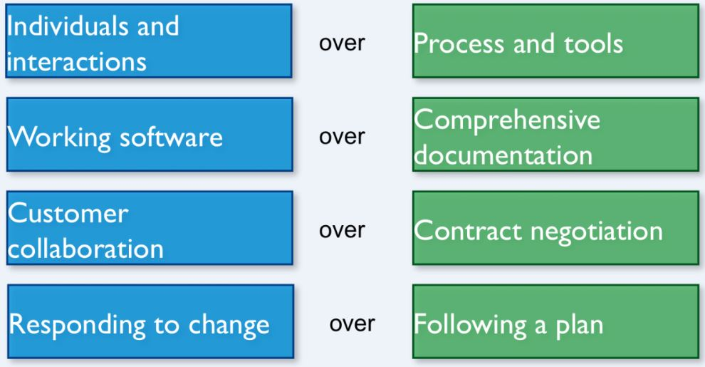
Agile Manifesto
2001 in Utah
By the 17 people, that have attended this meeting
More and more are signing this manifesto

Slide 5
Principles
1.Continuous delivery of value
2.Embrace changing requirements
3.Frequent deployment
4.Customer collaboration
5.Motivated indviduals
6.Face-to-face conversation
7. Working software as measure of progress
8. Sustainable development
9. Technical excellence
10. Simplicity
11. Self-organization
12.Continuous improvement

Slide 6
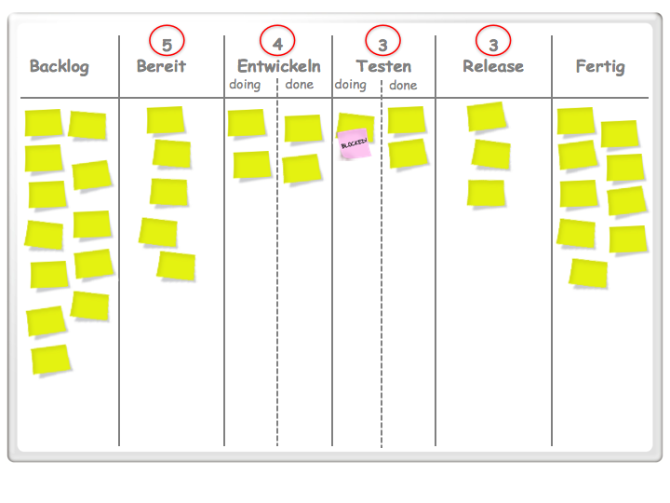
Kanban
Lean scheduling system developed by Toyota
Visual Queues
What to Produce
How Much to Produce
When to Produce
Canban Board
Visual Cards represent Items in product backlog
Order from new to Complete
Left to right
WIP Limits
Limits will show problems by making bottlenecks visible
Help to keep work flowing,
Save time
Complete tasks

Slide 7
Concentrates on the prozess and not on the product
Tries to improve the working process by simplifying and downsizing
Comes from Japan (Toyota)
Concept of sushimaster
Lean

Slide 8
Waterfall vs Agile

Slide 9
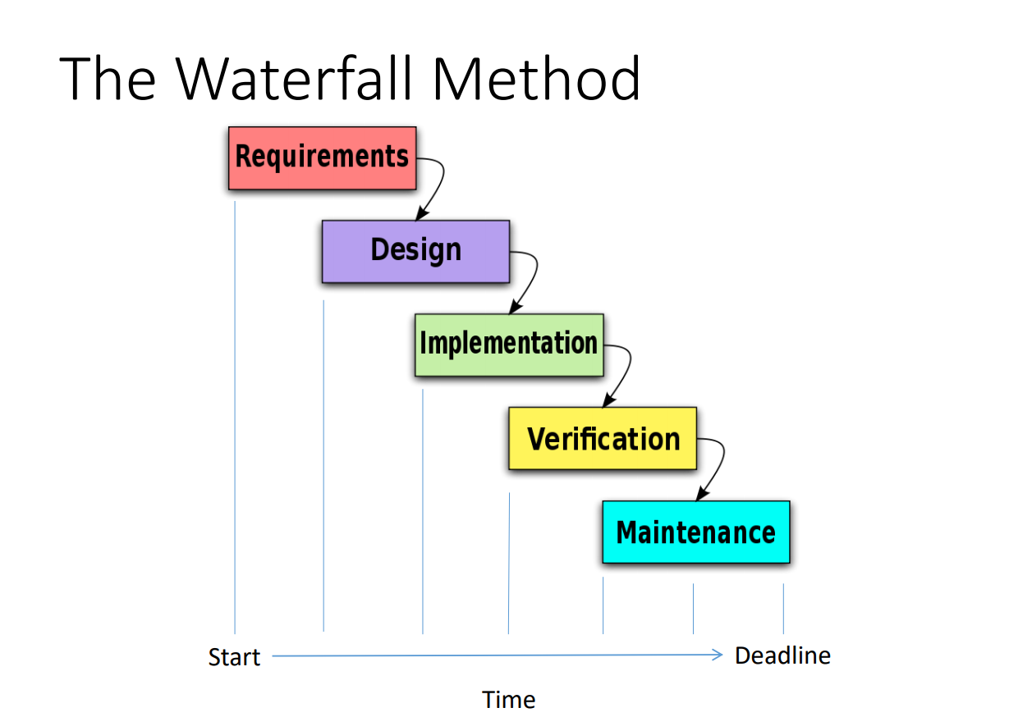
Waterfall
Linear approach to Software Development
Distinct Stages
Each step finishes before the next begins
Requirenments must be approved before designing
Pros:
Progress is easily messured,, because full scope is known
Team members can continue with other work
Customer presence not strictly required
Cons
Setting requirements is difficult
- Customer may be dissatisfied with product

Slide 10
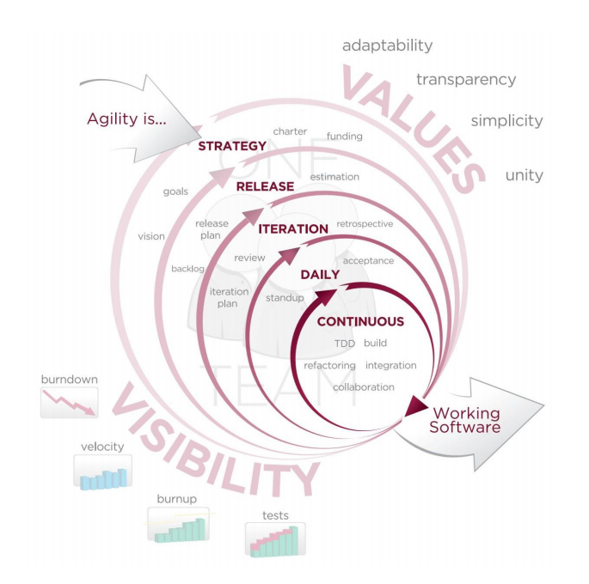
Agile
Pros
-Customer has frequent opportunities to see the work and make decisions
Customer gains strong sense of ownership
If time is more important than full featured product a more basic product can be delivered faster
Cons
High degree of customer involvement can be to much
Team has to be completely dedicated to project
Sometimes additional sprints are needed (higher costs)

Slide 11
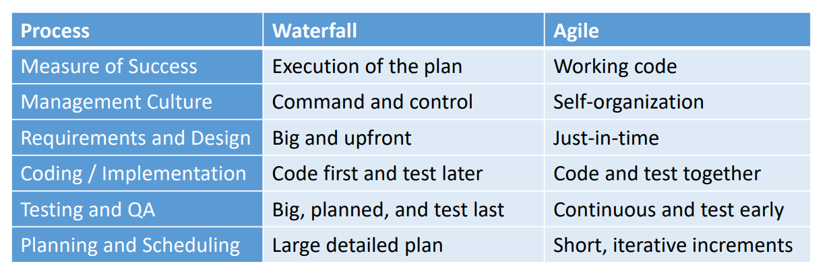

Slide 12
Scrum

Slide 13
Scrum
Framework
Lightweight
Simple to understand
Difficult to master
Mindset/Framework not a technique
→ Constant improvements of the product

Slide 14

Pillars
Transparency
Visibility into the project
Information radiators
End-Of-Sprint demos
Common definition of “done”
Inspection
Frequent inspecition of progress
Detection of undesirable variance
Not frequent enough to cause interference
Requires the right people doing the inspection
Adaptation
Adjustments are made to correct undesired variances
Adjusting earlier minimizes further deviation
Inspection and adaptation occurs during Scrum Events
Purpose is continuous improvement

Slide 15

Scrum Team
Is composed by three components
The Product Owner
The Scrum Master
The Development Group

Slide 16
Product Owner
Responsible for the worth of the product
Varies by the company, the scrum team the persons themselves
Creates the Product-Backlog => sort it in the best way to reach the goals
Shows, what the scrum team has to do next
Makes sure the Backlog is transparent

Slide 17
The Scrum Master
Explain the Scrum to the team according to the Scrum guide
=> Scrum- theorie, -practices, -rules and –value
Optimization of the groupwork
Communication between the Development Group and foreigners

Slide 18
Developers
Composed of experts
Develop the product out of the Product-Backlog
Only members of the Development Group are authorized to work on the product
There is no ranking in between the Group members
All developers could have special fileds but in at this project they are responsible as a group
Between 3 and 9 people!!!! => except Scrum Master and Product Owner

Slide 19
Scrum Events
All events are temporal limited
To base a regularity
Mistakes by missing one event
Sprints, Daily Scrums, Sprint Review, Sprint Retrospectives

Slide 20

‚The Heart‘ of Scrum
An avg. time frame of 2 weeks
Always the same Time frame
One Sprint done another sprints starts
A Sprint can be canceled by trading- or technology conditions
Each Sprint develops a software, the so called ‚DONE‘ increments
Sprints

Slide 21
Time frame of 15 minutes
Every day of a Sprint
Planning of the next 24 hours
Same Time and same Place
Checks work since the last Daily Scrum
Daily Scrums

Slide 22
At the end of each Sprint
‚Review‘ of the product and maybe changings of the Backlogs if necessary
Used as a meeting for feedback…. What was good? what was bad?
The Time frame is limited to 4 hours
Demonstration of the Product
Sprint Review

Slide 23
Happens between the Review and the next sprint
Time frame of three hours
The Team prepares a better working plan (better division of work)
Ideas to raise the product quality, if it does not konflict with the company standards
Sprint Retrospective

Slide 24
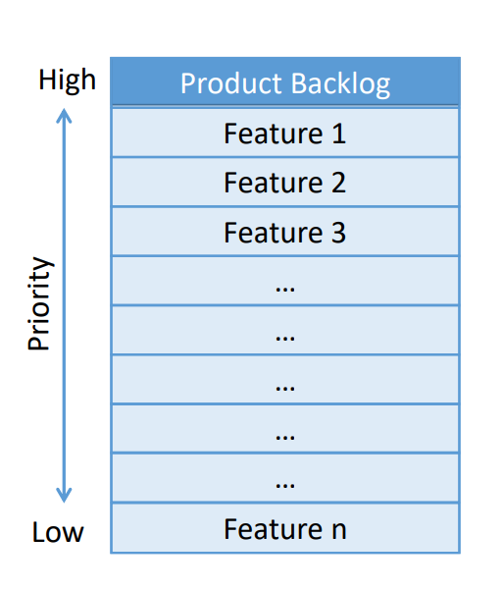
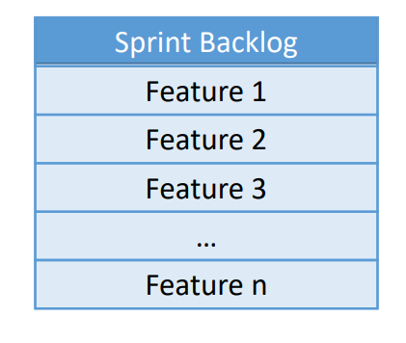
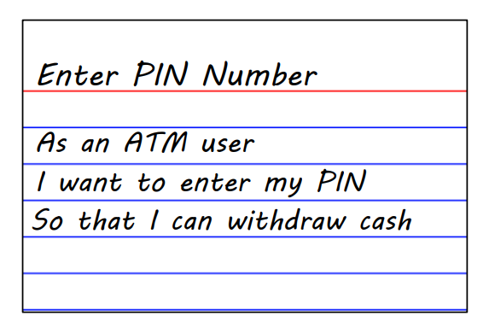
Artifacts
Represent work or value to provide transparency
Information radiators
End-Of-Sprint demos
Common definition of “done”
Product Backlog
Ordered list of everything that is known to be needed in the product
Ordered by business Value / ROI
Create and deliver features in order
Owned by product owner
Sprint Backlog
List of features to be completed during sprint
Owned by the development team
No work can be added without teams approval
Highly visible to everyone
Backlog Items
User Stories
Bugs
Architecture
Technical Dept
Research

Slide 25
Scrum process
Daily Scrum
24
hours
30
days
Product Backlog
Sprint
Sprint Backlog
Working increment of the product

Slide 26
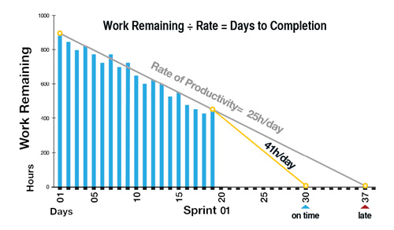
Burndown Chart

Slide 27
Sources
https://www.dasscrumteam.com/de/scrum
https://www.scrumguides.org/docs/scrumguide/v2017/2017-Scrum-Guide-US.pdf
https://t3n.de/news/lean-vs-agil-beiden-ansaetze-667334/
https://www.wibas.com/de/scrum/
https://en.wikipedia.org/wiki/Extreme_programming
https://www.youtube.com/watch?v=CD0y-aU1sXo
https://www.youtube.com/watch?v=XU0llRltyFM

